Slide 1
DevOps Workshop, Part II

Slide 2
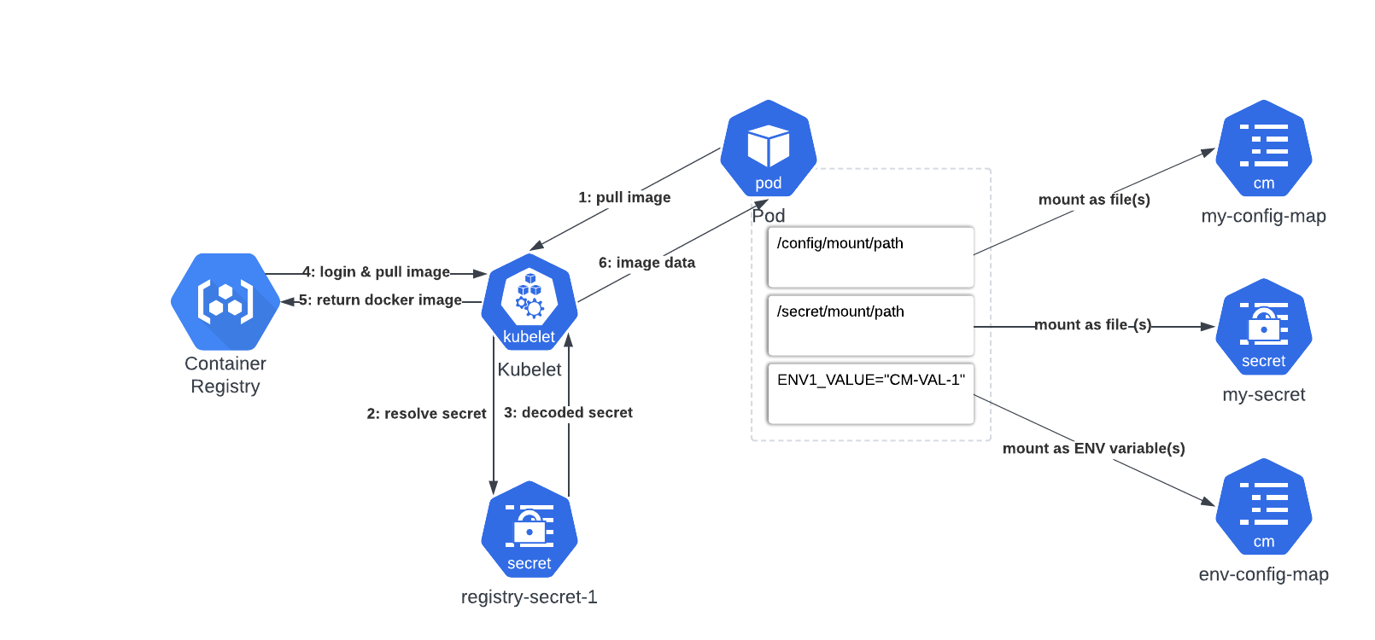
Configmaps & Secrets
WHY do we need this?
To ease configuration process.

Slide 3
Secret types
WHY do we need this?
To make secret purpose clearer for user.
Built-in Type | Usage
Opaque | arbitrary user-defined data
kubernetes.io/service-account-token | ServiceAccount token
kubernetes.io/dockercfg | serialized ~/.dockercfg file
kubernetes.io/dockerconfigjson | serialized ~/.docker/config.json file
kubernetes.io/tls | data for a TLS client or server

Slide 4
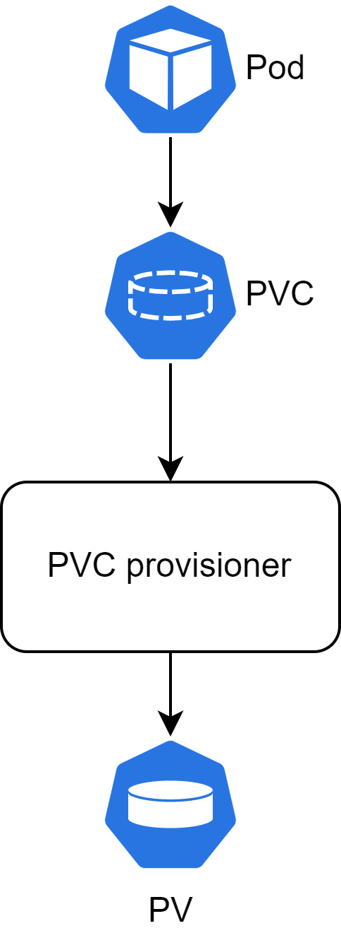
PV(C)
WHY do we need this?
To make applications stateful.

Slide 5
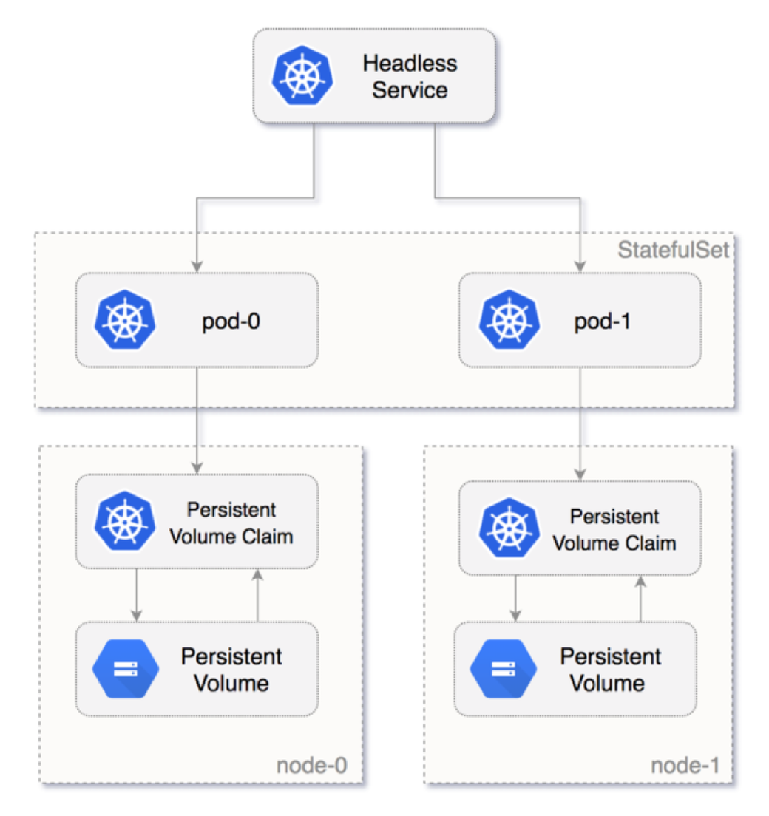
Stateful Sets
WHY do we need this?
To make stateful applications scalable.

Slide 6
Stateful Sets DNS
WHY do we need this?
To use cluster DNS for communication with distributed stateful applications.
Cluster Domain | Service (ns/name) | StatefulSet (ns/name) | StatefulSet Domain | Pod DNS | Pod Hostname
cluster.local | foo/nginx | foo/web | nginx.foo.svc.cluster.local | web-{0..N-1}.nginx.foo.svc.cluster.local | web-{0..N-1}

Slide 7
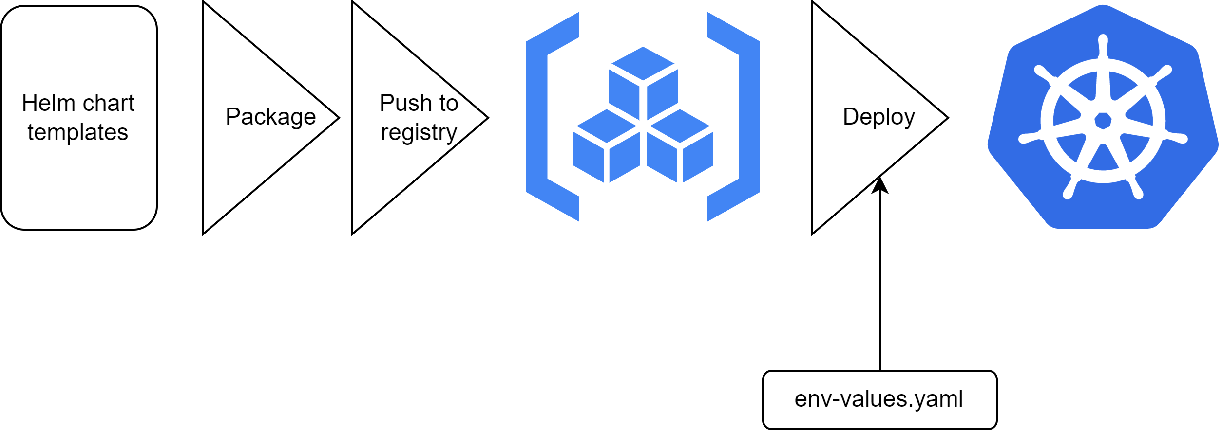
HELM
WHY do we need this?
To ease and unify deployment configuration for different envs.

Slide 8
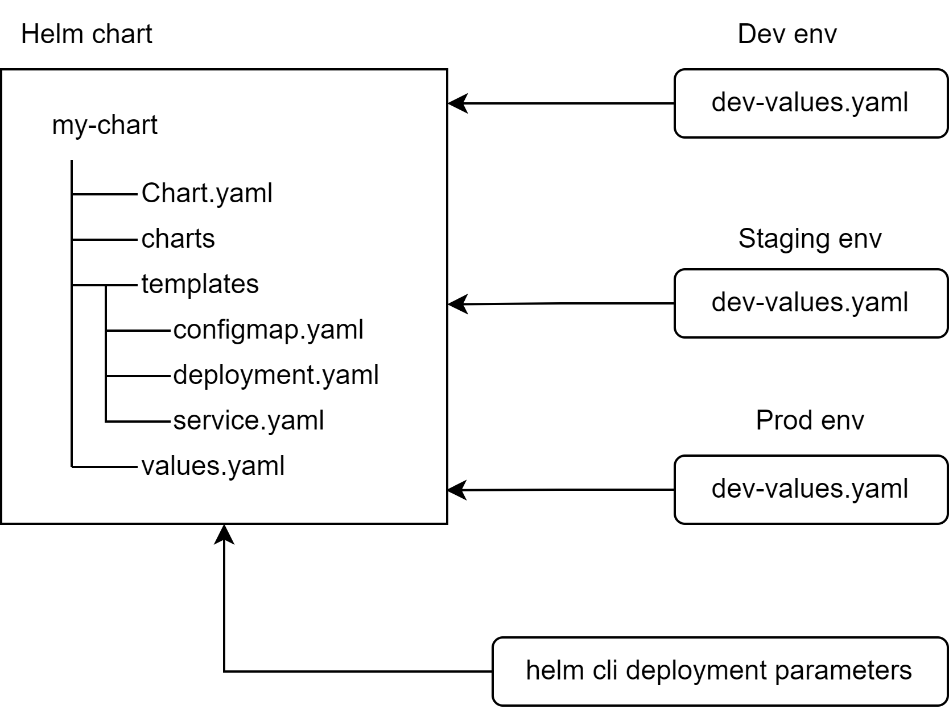
HELM Layout
WHY do we need this?
To ease and unify deployment configuration for different envs.

Slide 9
HELM Templating
WHY do we need this?
To ease and unify deployment configuration for different envs.
Template service.yaml
values.yaml
apiVersion: v1
kind: Service
metadata:
name: {{ include "my-chart.fullname" . }}
labels:
{{- include "my-chart.labels" . | nindent 4 }}
spec:
type: {{ .Values.service.type }}
ports:
- port: {{ .Values.service.port }}
targetPort: http
protocol: TCP
name: http
selector:
{{- include "my-chart.selectorLabels" . | nindent 4 }}
replicaCount: 1
image:
repository: nginx
service:
type: ClusterIP
port: 80

Slide 10
HELM Templating
WHY do we need this?
To ease and unify deployment configuration for different envs.
helm template my-release-name my-chart/

Slide 11
HELM Templating
WHY do we need this?
To ease and unify deployment configuration for different envs.
Template service.yaml
service.yaml
apiVersion: v1
kind: Service
metadata:
name: my-release-name-my-chart
labels:
helm.sh/chart: my-chart-0.1.0
app.kubernetes.io/name: my-chart
app.kubernetes.io/instance: my-release-name
app.kubernetes.io/version: "1.16.0"
app.kubernetes.io/managed-by: Helm
spec:
type: ClusterIP
ports:
- port: 80
targetPort: http
protocol: TCP
name: http
selector:
app.kubernetes.io/name: my-chart
app.kubernetes.io/instance: my-release-name
apiVersion: v1
kind: Service
metadata:
name: {{ include "my-chart.fullname" . }}
labels:
{{- include "my-chart.labels" . | nindent 4 }}
spec:
type: {{ .Values.service.type }}
ports:
- port: {{ .Values.service.port }}
targetPort: http
protocol: TCP
name: http
selector:
{{- include "my-chart.selectorLabels" . | nindent 4 }}

